Slide 1
Junior developer Yejin Lee
First
PROJECT
First web page creation

Slide 2
Table of contents
01
02
Project
introduction
Production pages
03
finish
Production page introduction
⦁ Main screen
⦁ Sign up
⦁ Duplicate check
⦁ Edit member information
⦁ Bulletin board list
⦁ Writing page
⦁ View page
⦁ Comment area (create/edit/delete)
⦁ Post edit page
⦁ View my posts/comments
⦁ (Administrator) Membership management
⦁ (Administrator) Bulletin board management
Brief introduction to the project
Closing and Q&A

Slide 3
01
intro
Brief introduction to the project

Slide 4

introduction of this project
dodo
⦁ With the creation of our first homepage, we tried to focus on development basics and concept organization.
⦁ I've always been very interested in pets, so I created a simple pet community.
⦁ Production period was 2 weeks for development and coding, and 1 day for portfolio production.

Slide 5








project environment
[FRONT-END]
[IDE TOOL & SERVER]
[BACK-END]

Slide 6
02
Production pages
Full page implementation features and introduction

Slide 7
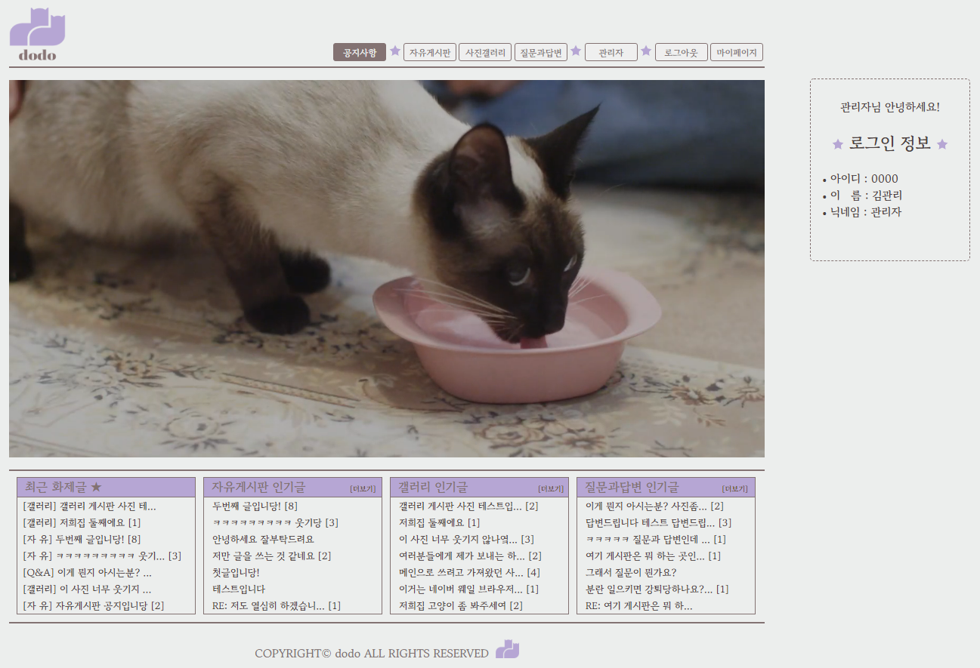
Main page
⦁ Implementation of logo and menu button in the top header area
⦁ Main index page video loop playback
⦁ Print some posts with high views on the entire bulletin board
⦁ Same as free bulletin board/gallery/Q&A bulletin board
⦁ Print current login session information on the right
⦁ Copyright output in bottom footer area

Slide 8
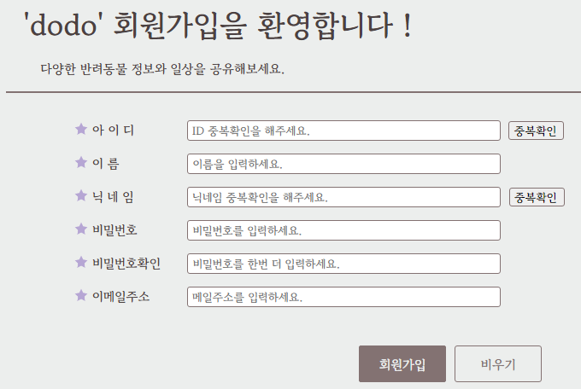
2. Sign-up page
⦁ Input area form tag validation using onsubmit
⦁ Use ID and nickname input readonly
⦁ Implementation of ID duplication check and nickname duplication check
(Similarly, validation using form tag onsubmit)

Slide 9
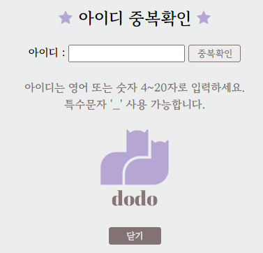
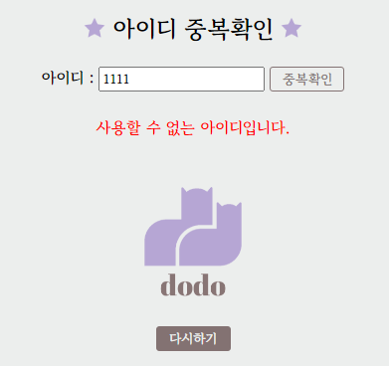
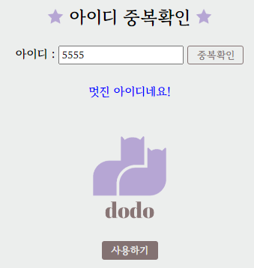
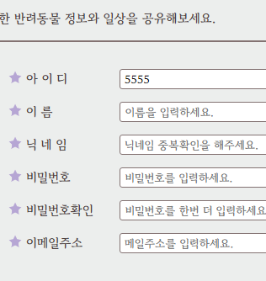
2-1. duplicate check
⦁ Specify input tag input format
⦁ A message is output if there are duplicate IDs or if there are no duplicate IDs.
⦁ If the ID is available, when you click Use, the value is passed to the ID window on the previous screen.

Slide 10

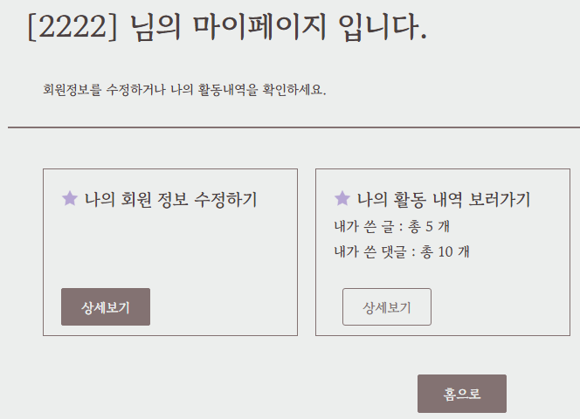
3. my page
⦁ Change header area button upon successful login
⦁ Edit member information -> Edit information page
⦁ View activity history -> You can check my posts/comments
⦁ Print the total number of posts/comments written by me on all bulletin boards

Slide 11
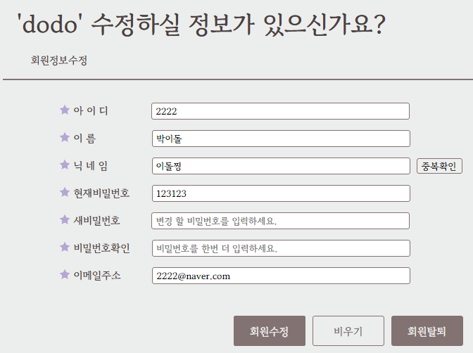
3-1. Member info modify
⦁ Go to My Page by clicking Edit
⦁ ID and name are readonly
⦁ When changing nickname, double check is required.
⦁ Validation is carried out just like membership registration.
⦁ When withdrawing membership, proceed with withdrawal after confirmation.

Slide 12
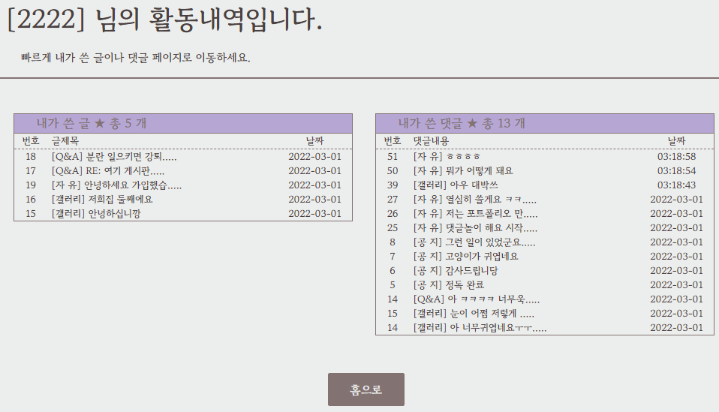
3-2. My writing page
⦁ You can check all my posts and all comments in real time
⦁ Use of [ ] header for each bulletin board
⦁ Click on the article title to go to the article view page

Slide 13

4. Bulletin board system
⦁ Create 4 bulletin boards
⦁ Notice: Integrated notice bulletin board, only available to administrators, general members can only write comments
⦁ Free bulletin board: All members can write freely, but only administrators can use notice posts.
⦁ Gallery: All members can write freely, but only administrators can use announcement posts.
Print thumbnails to list
⦁ Questions and Answers: All members can write freely, but only administrators can use announcement posts.
Secret posts not possible, image output to easily distinguish between questions and answers

Slide 14
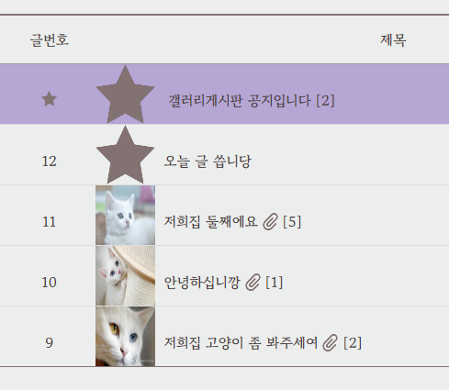
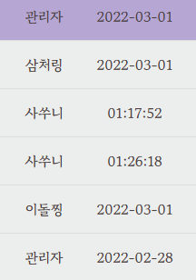
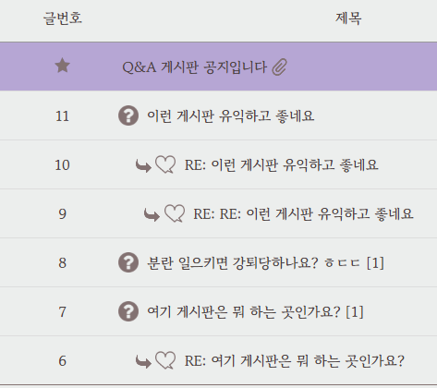
4-1. Bbs list page
⦁ Gallery bulletin board and Q&A bulletin board list
⦁ The author implemented it so that nicknames are displayed.
⦁ Prints the time for today’s posts, and prints the date for past posts.

Slide 15
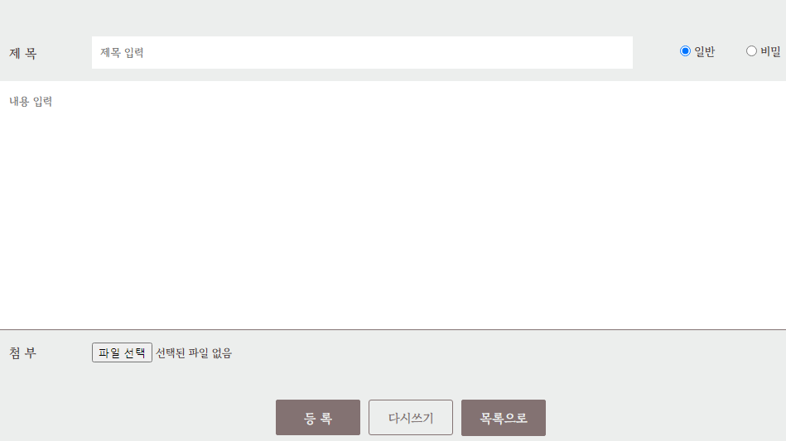
5.WRITE PAGE
⦁ For administrators, notice options are also printed.
⦁ When you click Rewrite, all contents are cleared

Slide 16
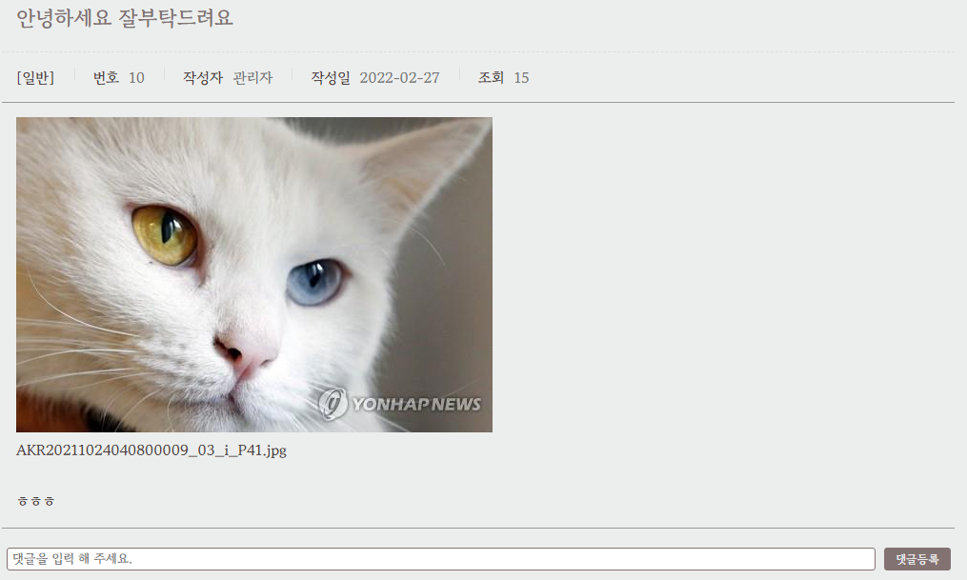
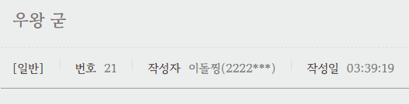
6. VIEW page
⦁ If the author is an administrator, only the nickname (administrator) is displayed.
If you are a general member, your nickname (ID 4 letters) will be printed.
⦁ As with the list page, the writing date is as follows:
Print time, print date for previous posts
⦁ Comment writing area and comment list output at the bottom of the text area

Slide 17
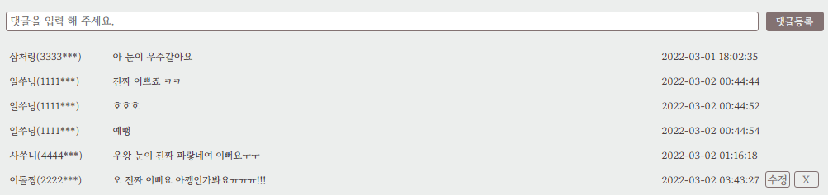
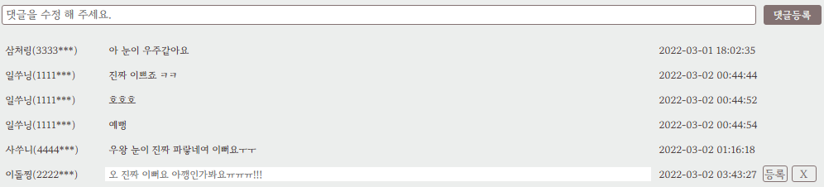
6-1. COMMENT AREA
⦁ List of written comments sorted by newest
⦁ As with list and view pages, the author
For administrators, only the nickname (administrator) is displayed.
In case of general members, nickname (ID 4 letters) is printed
⦁ Only if it is your own comment or if you are an administrator
Print edit and delete buttons
⦁ When the edit button is clicked, only the relevant area is input processed.
Original comments are treated as placeholders
⦁ When you click the registration button, you can edit the comment and go back to the view page.

Slide 18
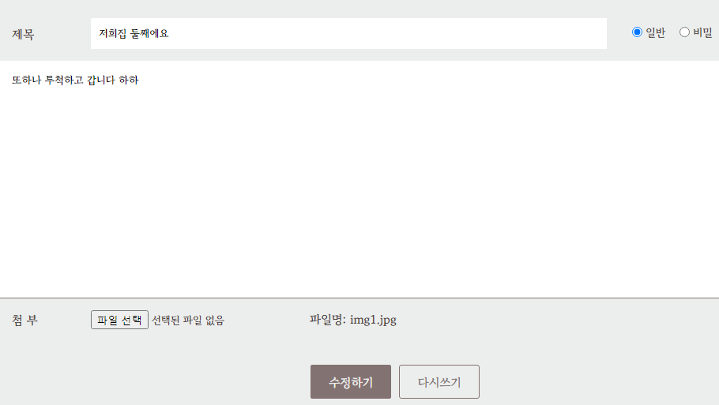
7. MODIFY page

Slide 19
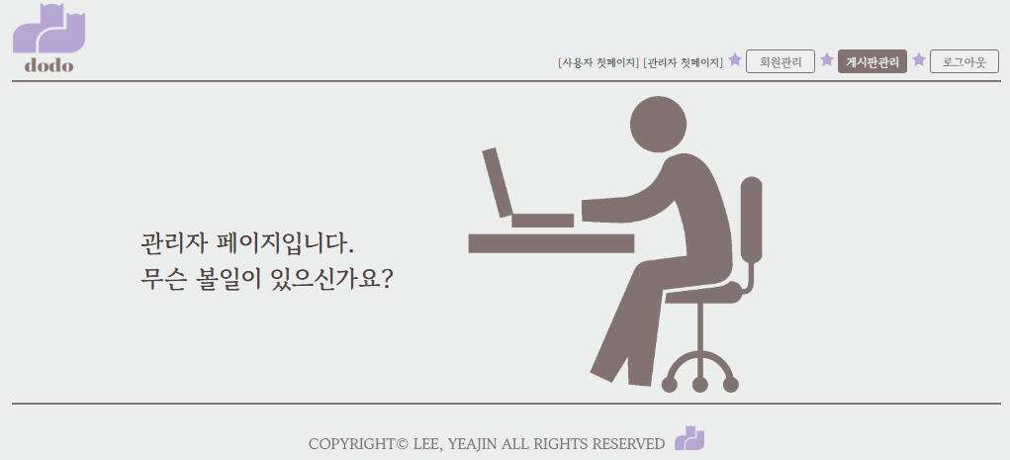
8. Admin main page
⦁ Add header area button when logging in as administrator
⦁ Click on the admin button to go to the admin page
⦁ Membership management, bulletin board management page implementation

Slide 20
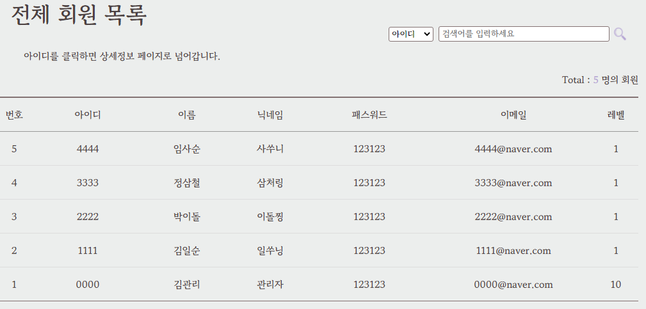
9. Admin member-list page
⦁ When you click the member management button, the entire member list is printed.
⦁ Click on ID to go to member edit page

Slide 21
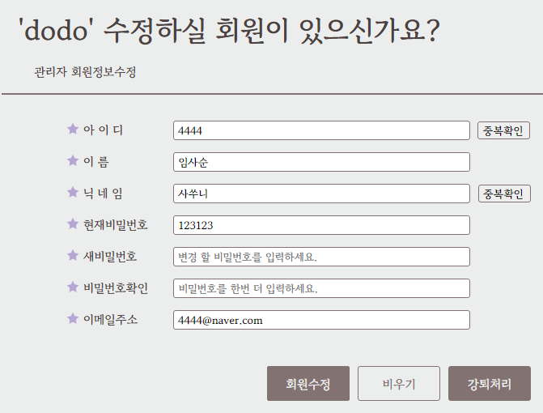
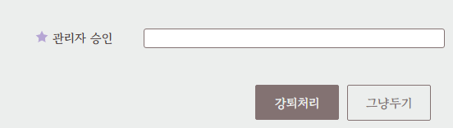
9-1. Member update page
⦁ All information except the current password can be modified by administrator
⦁ As with membership registration, ID and nickname need to be double-checked when changing.
⦁ Membership withdrawal possible
⦁ Request to enter administrator password when processing membership withdrawal
If they match, withdrawal will be processed. If they do not match, alert will be processed.

Slide 22
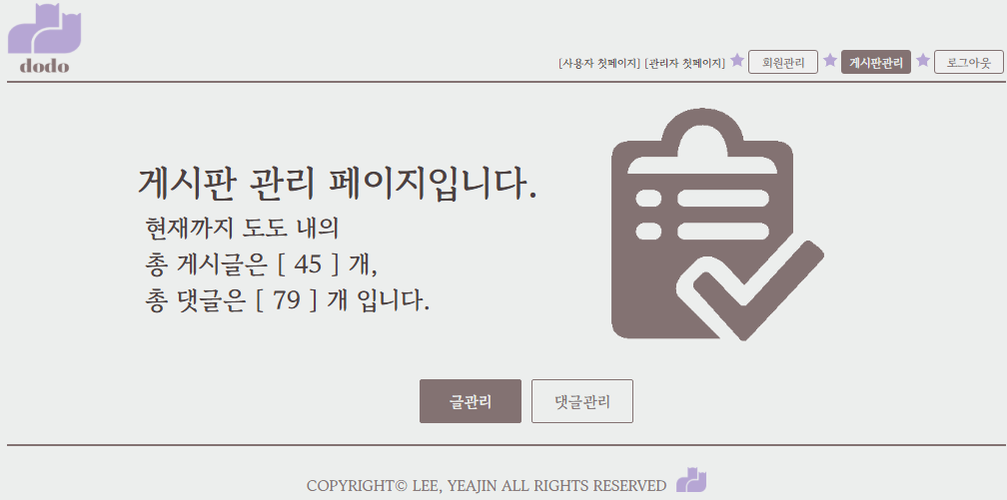
10. admin bbs page
⦁ Print the number of posts and comments registered on the entire bulletin board on the homepage
⦁ When you click the post management or comment management button, you will be taken to the corresponding management page.

Slide 23
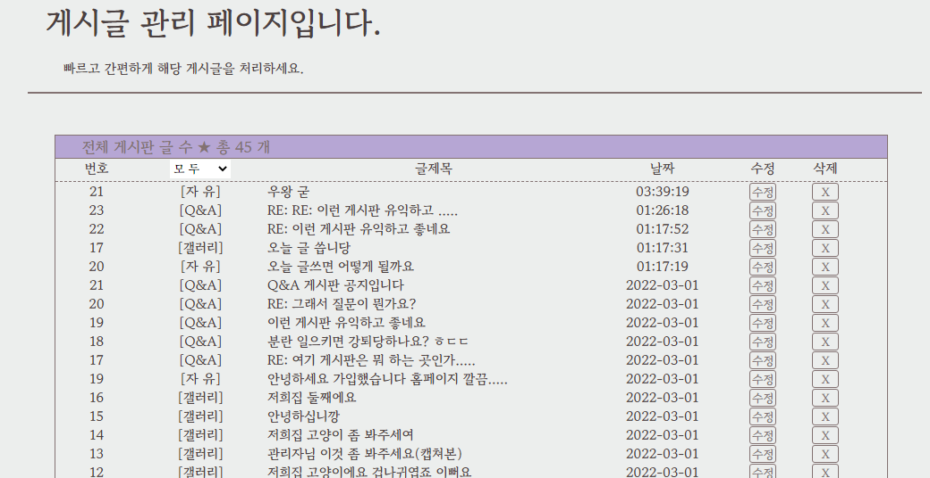
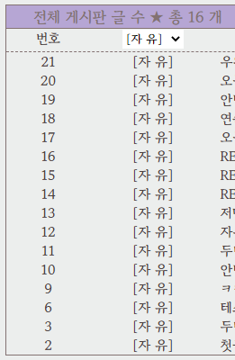
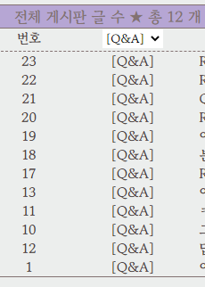
10-1. admin writing page
⦁ Print the number of posts registered on all bulletin boards on the homepage
⦁ When you select the dropdown, only the relevant bulletin board posts are loaded without duplication.
⦁ Click on the title to go to the view page of the article
⦁ Click the edit button to go to the modify page, and click the delete button to immediately delete the post.

Slide 24
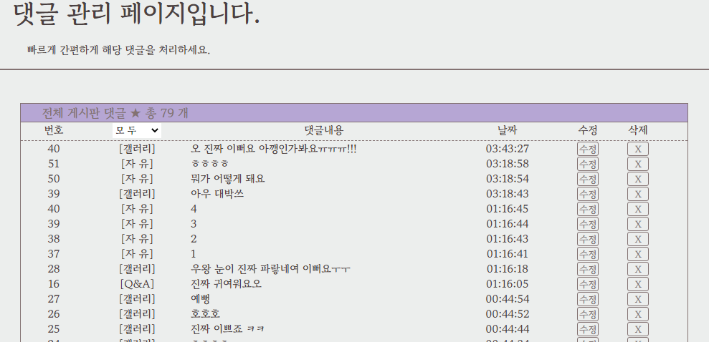
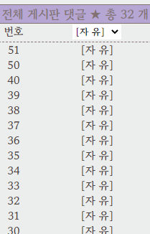
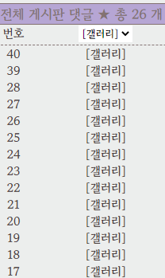
10-2. admin comment page
⦁ Print the number of comments registered on the bulletin board on the homepage
⦁ When you select the dropdown, only the relevant bulletin board comments are loaded without duplication.
⦁ Click on the title to go to the view page for the comment
⦁ When you click the edit button, you go to the view page, and when you click the delete button, the comment is immediately deleted.

Slide 25
03
finish
In conclusion

Slide 26
Review and Q&A
Because it was my first project, I was very nervous and wondered if I could do well.
However, as you progress, there are many things you become familiar with.
It was amazing and fun to see the process being implemented right away on the web.
The moment I came up with an idea, Googled it, and finally realized it was truly thrilling.
I wanted to add as many features as I could think of, but I didn't have enough time.
Since I am a beginner, there are limits to the tools and languages I can use.
I had a lot of regrets about not being able to do that as much as I wanted.
Still, it was a process I was proud of finishing.
Thank you for watching!

Slide 27
thanks
thank you !

